Slide 1
Sproughton Church of England Primary School
Neighbourhood Plan Survey results.
Rhona Jermyn Sproughton Neighbourhood Plan

Slide 2
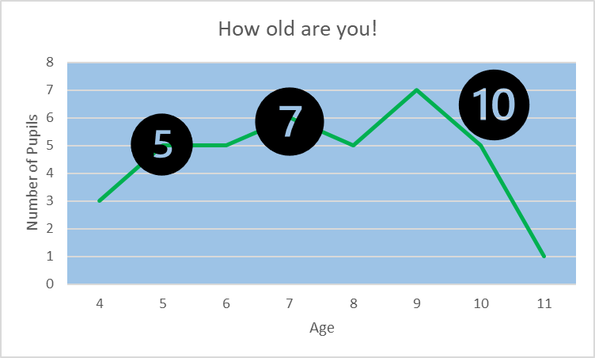
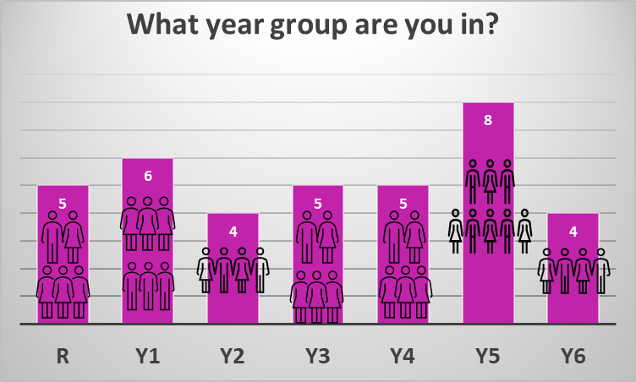
All about you & your school!
There are 103 pupils in your school and 38 replied to our survey. That is a very good reply of 37%.
So well done all of you!

Slide 3
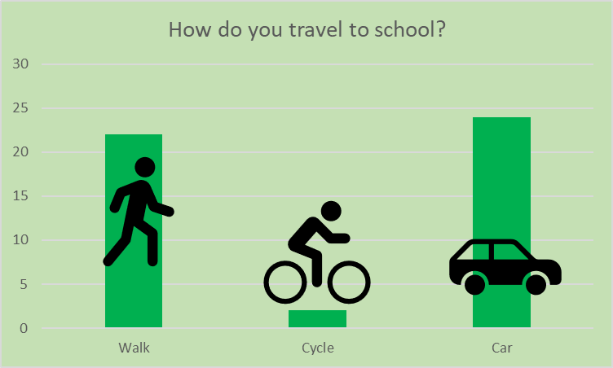
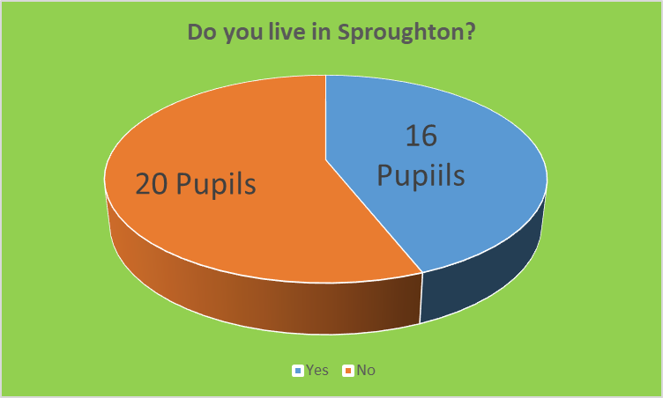
All about you & your school!
Sometimes you walk and sometimes you come by car! Must depend on if its raining!!

Slide 4
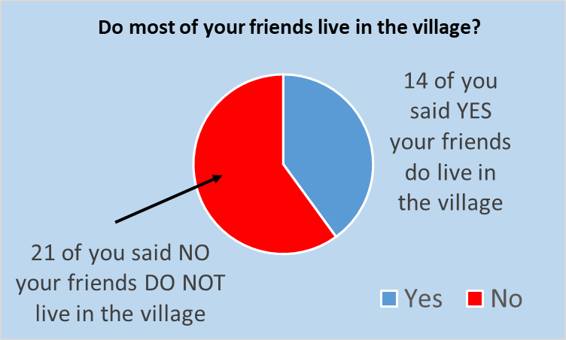
All about you & your school!
That it is a nice and quiet and it has lots of nice people living in it and the school is fantastic and amazing.
All the conkers and chestnut trees. I like the children's playing area and park. I like walking across the field, the woods and the allotments. I like that all my friends live in the village.
The allotments because we get to see the chickens playing at the park with my friends going for walks along the fields and in the woods
I like the Sproughton park its fun to play in. I like the river walk. I like my school and its teachers.
It is quiet, clean, safe and a good neighbourhood.

Slide 5
No! Very busy lots of on road parking unsafe for animals and small children on main roads.
Yes because it’s a nice village and I love walking to school so I can walk to school more often and it wont take as long as it does.
Yes because it would be easier to get to school
Yes because there is a park and a shop and some of my friends live there.
Yes because I want to be closer to family and it is quiet.
Yes it’s a quiet area.

Slide 6
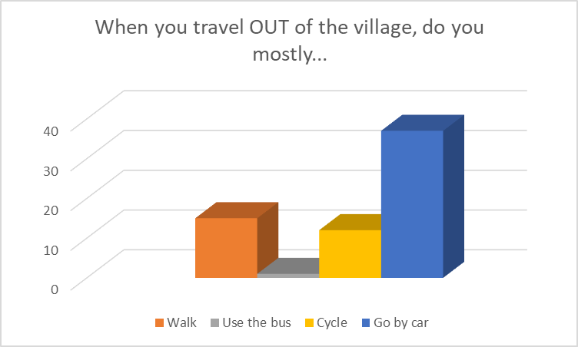
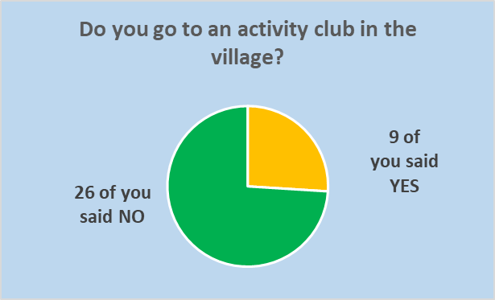

Travel and clubs!

Slide 7







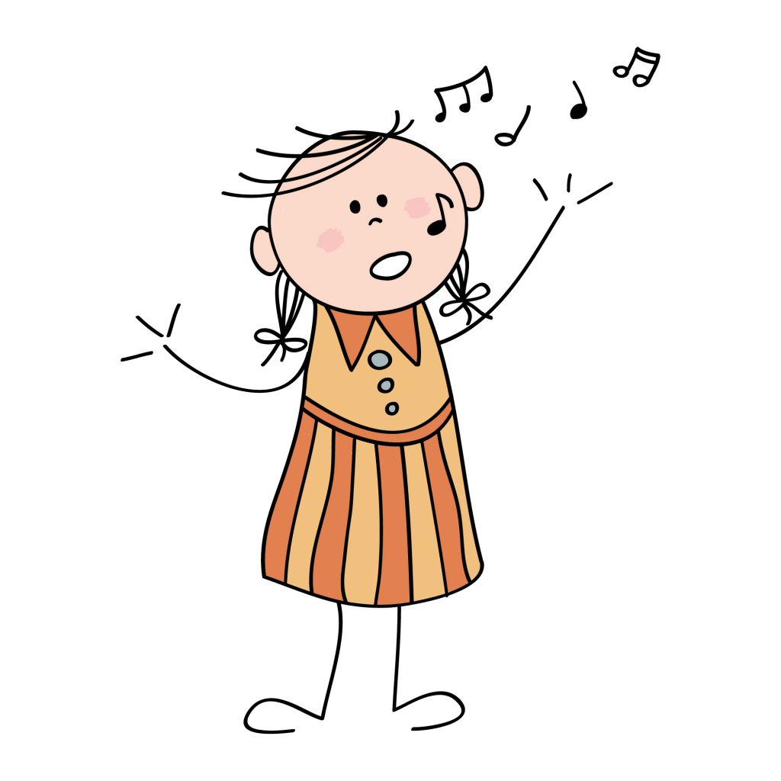
What sort of club would you like?
Rainbows
Cricket
Tennis Club
Swimming
Garden club
Arts and Crafts
Singing dancing club
Brownies
Golf and Karate
Cheerleader
This Photo by Unknown Author is licensed under CC BY

Slide 8
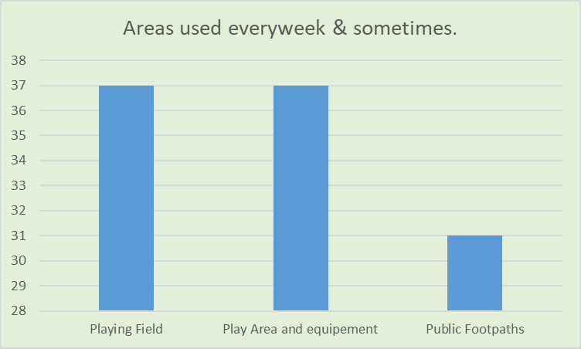
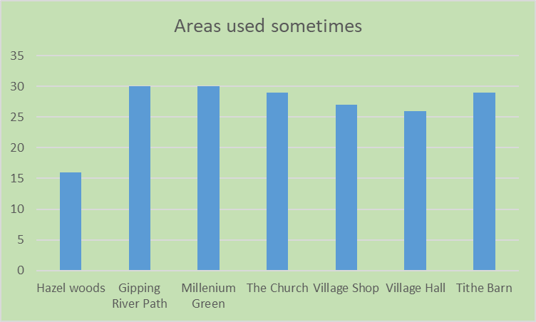
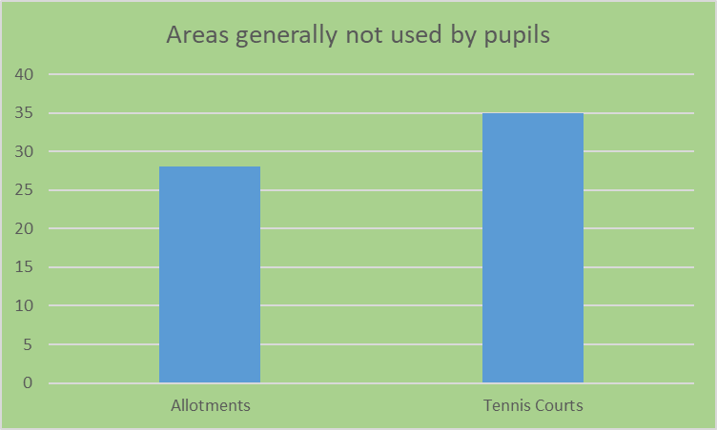
Areas you use the most are….The playing field and play area and equipment!
Areas in the village you use every week, sometimes and never!!

Slide 9
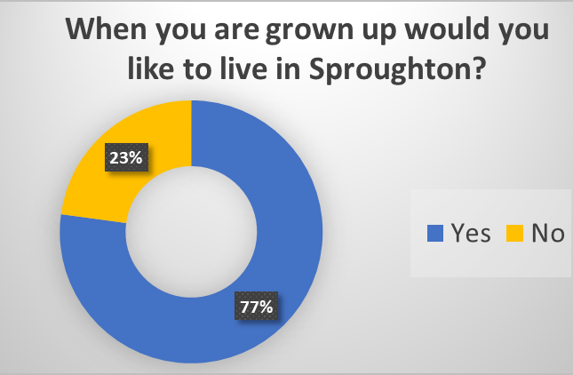
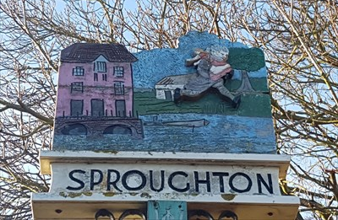

All about housing!
When you are grown up would you like to live in Sproughton?

Slide 10
When you are grown up would you like to live in Sproughton? If not why???
Because there is a lot of traffic
Because I already live in Sproughton I want to explore other places.
I like the new area I'm in so when I am older I want to live there.
To life in a bigger village or town
I want to live in the countryside
A new environment and explore a new part of the world.

Slide 11
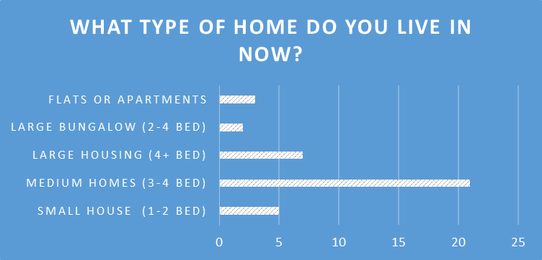
What type of home do you live in now?

Slide 12
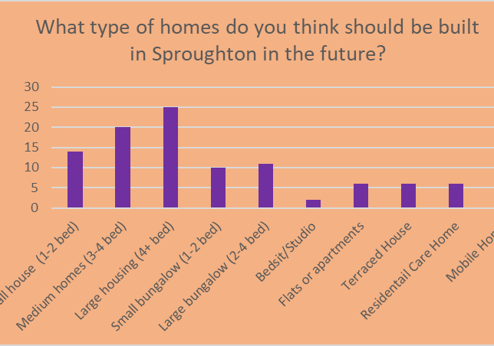
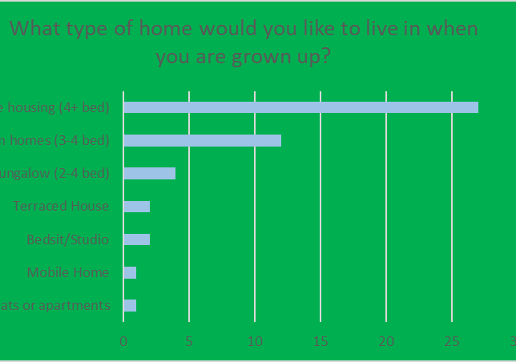
Most of you want to live in a large 4 bedroom house when you grow up!

Slide 13
Competition winners
Entry Group 1 Reception, Years 1 &2
1st Prize Family Ticket to Jimmys Farm – Annabel Lord-Vince
Reception Explorers Class
2nd Prize Drawing Pad & Art pens – Harrison Rolf Year 1
3rd Prize £10 Amazon Voucher – Owen Charles Year 2
Entry Group 2 Years 3,4,5 & 6
1st Prize Family Ticket to Jimmys Farm – Age 8 Year 4 ??
2nd Prize Drawing Pad & Art pens - Tayler Clark Year 4
3rd Prize £10 Amazon Voucher – Maya Austin Year 6
Special commendation
Zak Booth Year 6 for his comments on what Sproughton Represents.

