Slide 1
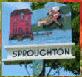
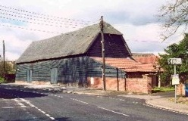
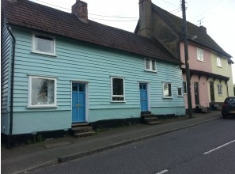
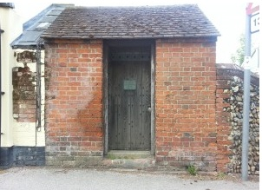
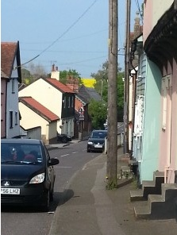
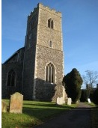

Sproughton Neighbourhood Plan
Public Exhibition 4-6 Sep 20
‘A Presentation on the Results of the Household Survey’ – Exhibition Photos

Slide 2
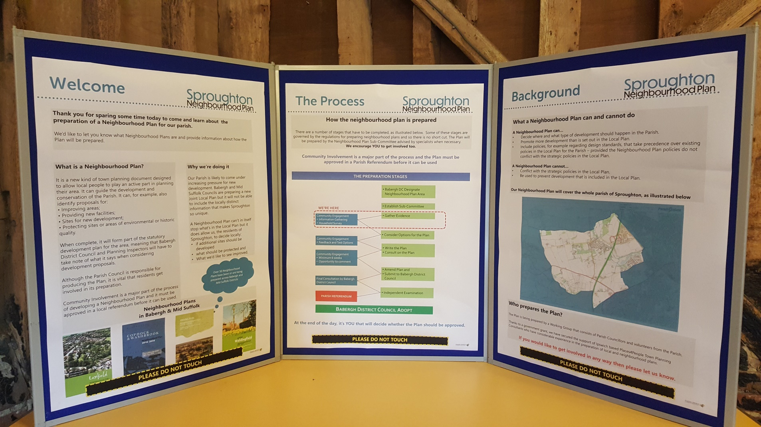
Board 1 – Intro to Neighbourhood Planning

Slide 3
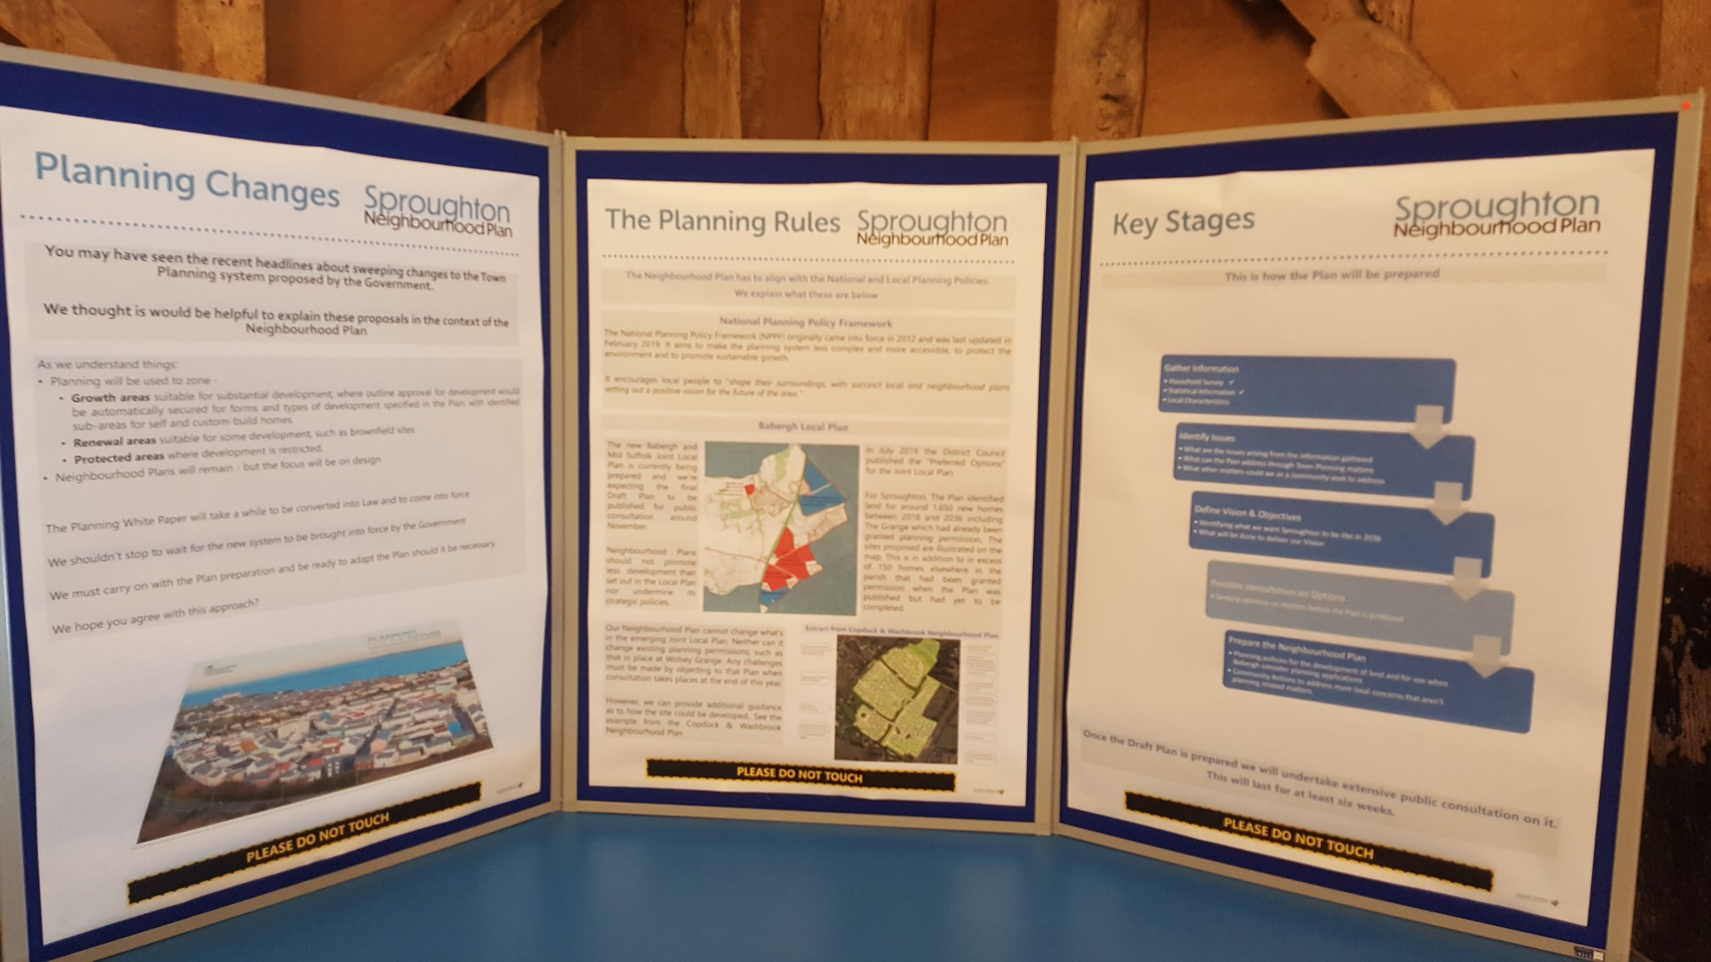
Board 2 – Intro to Neighbourhood Planning

Slide 4
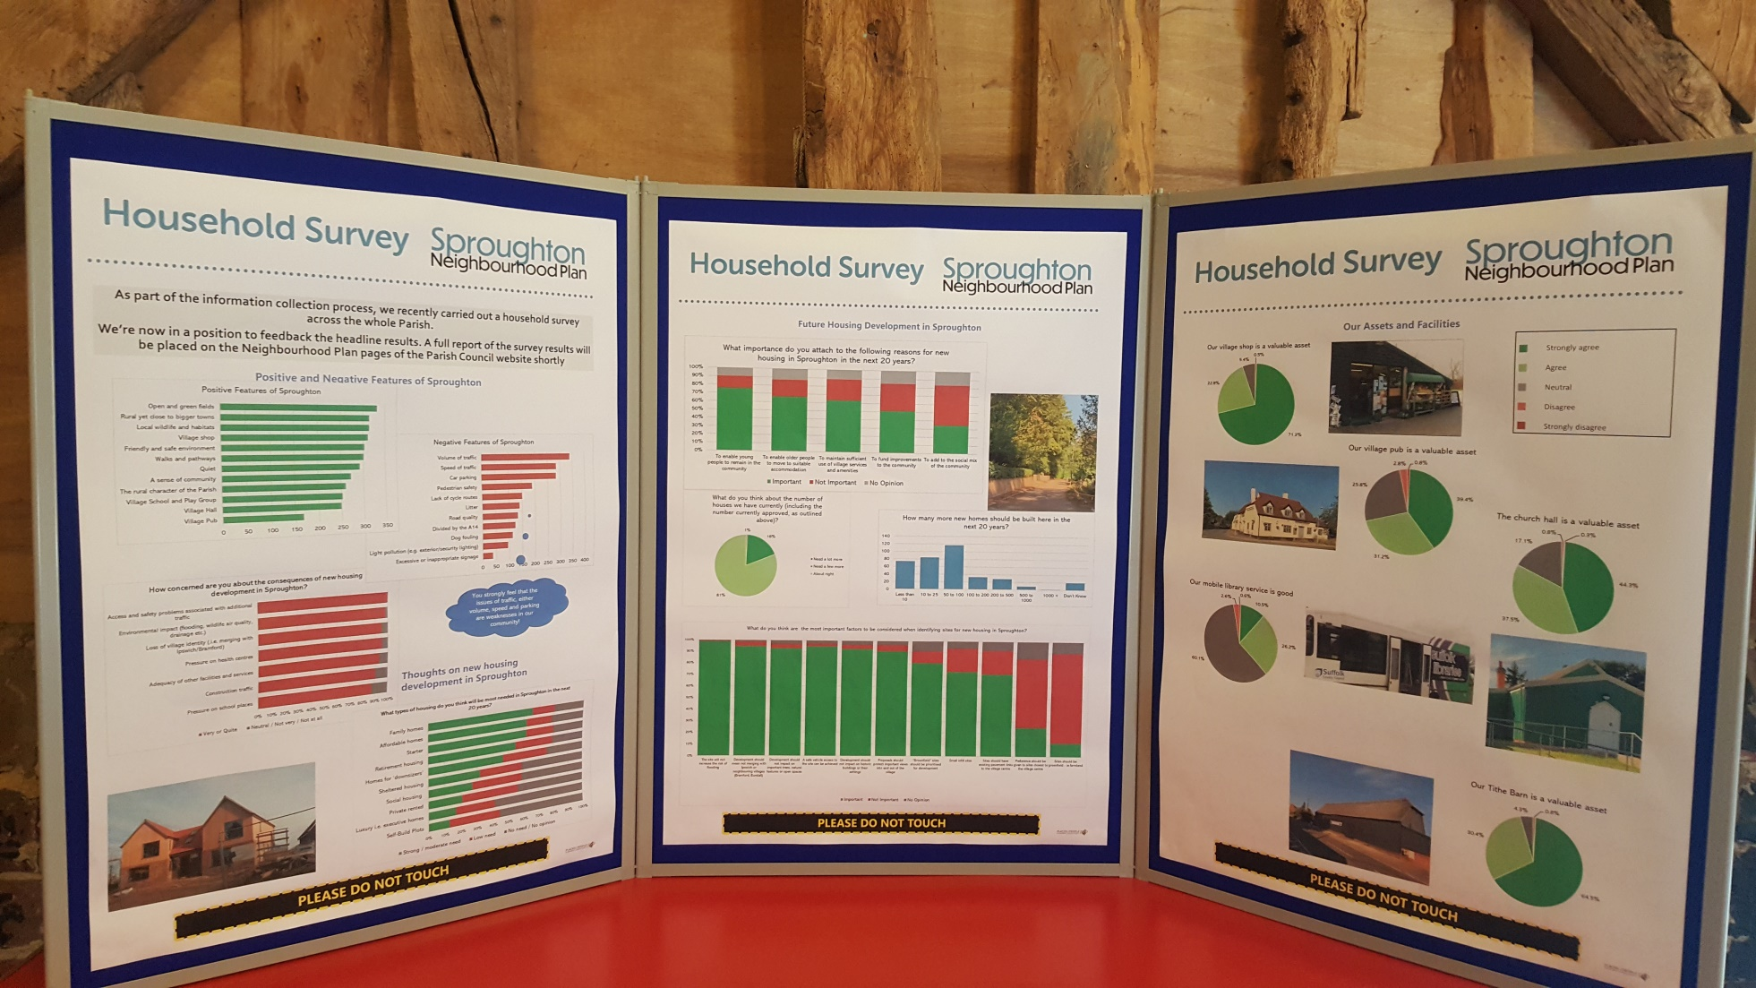
Board 3 – Results of Household Survey 1

Slide 5
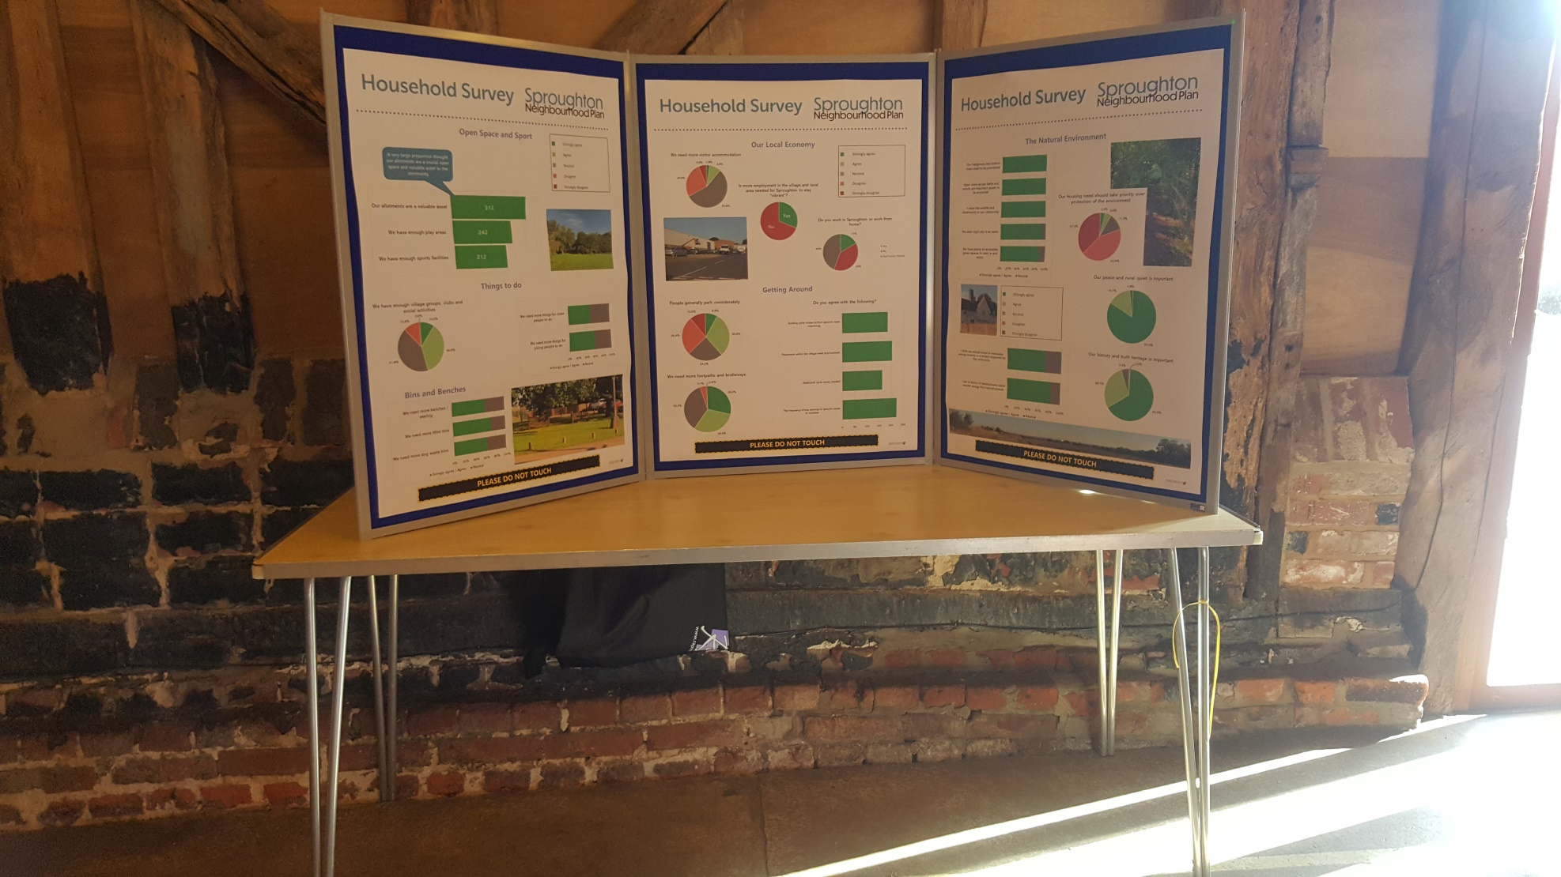
Board 4 – Results of Household Survey 2

Slide 6
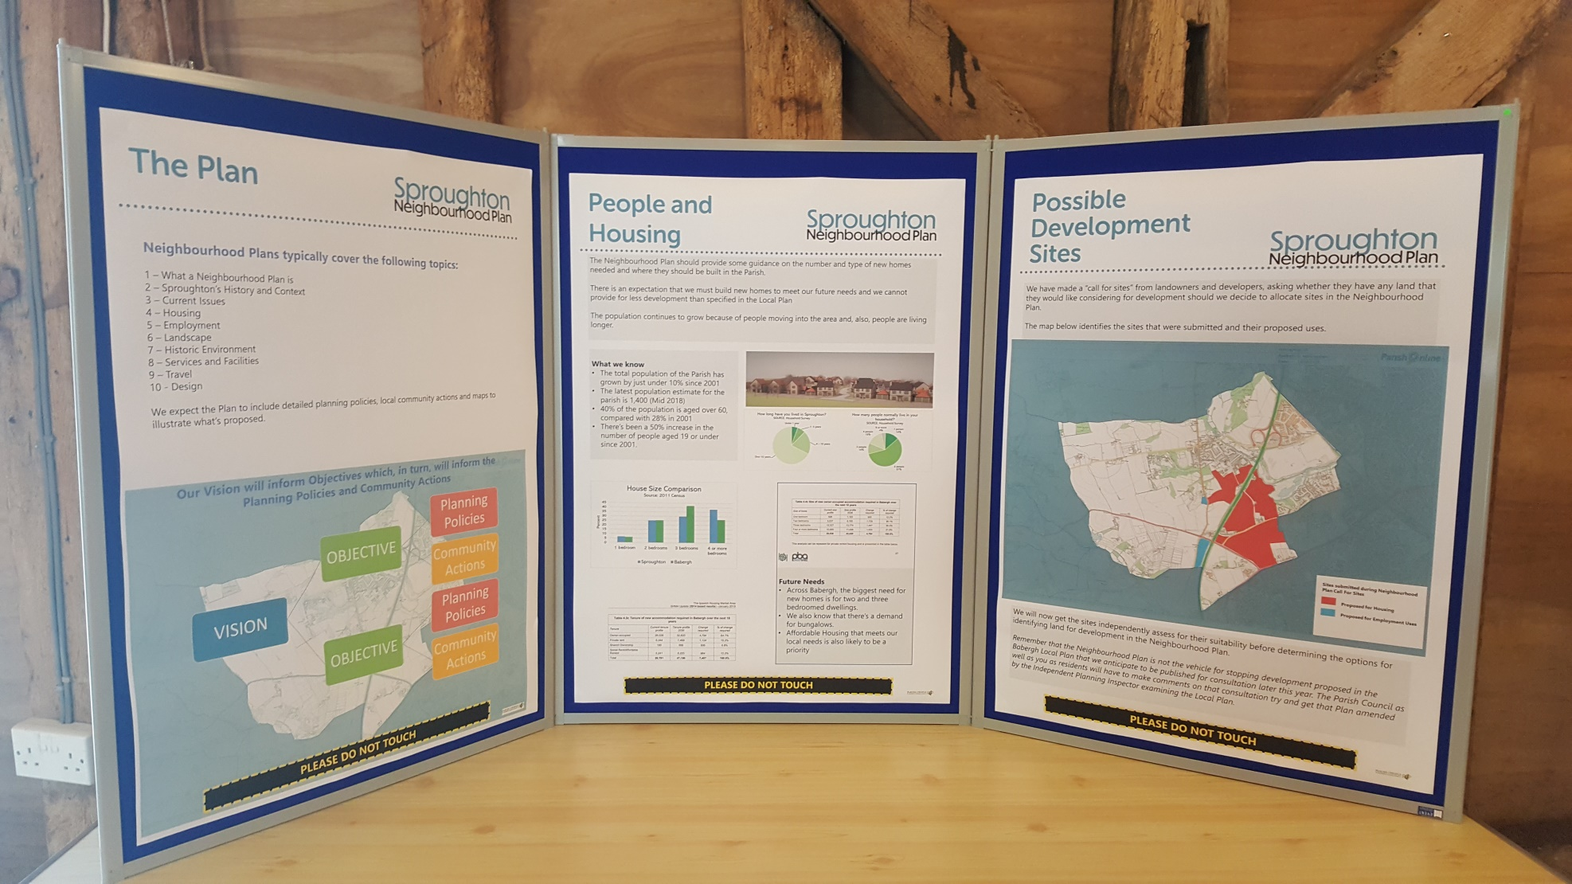
Board 5 – The Plan: People & Housing

Slide 7
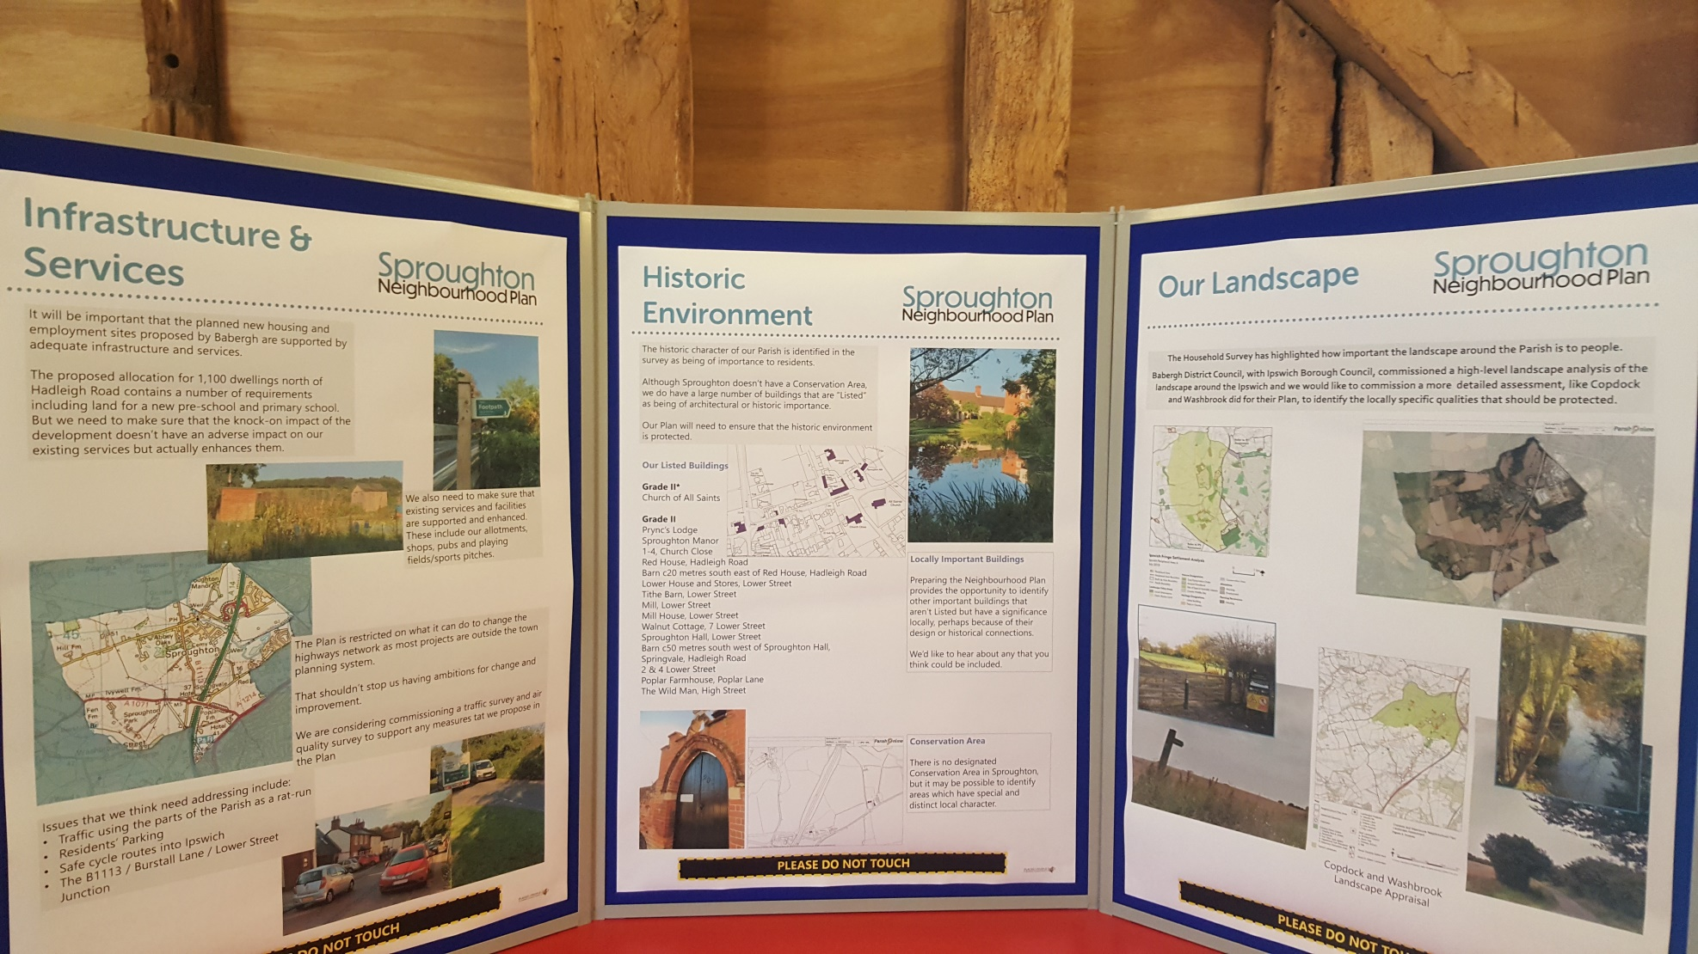
Board 6 – Infrastructure, Heritage, Landscape

Slide 8
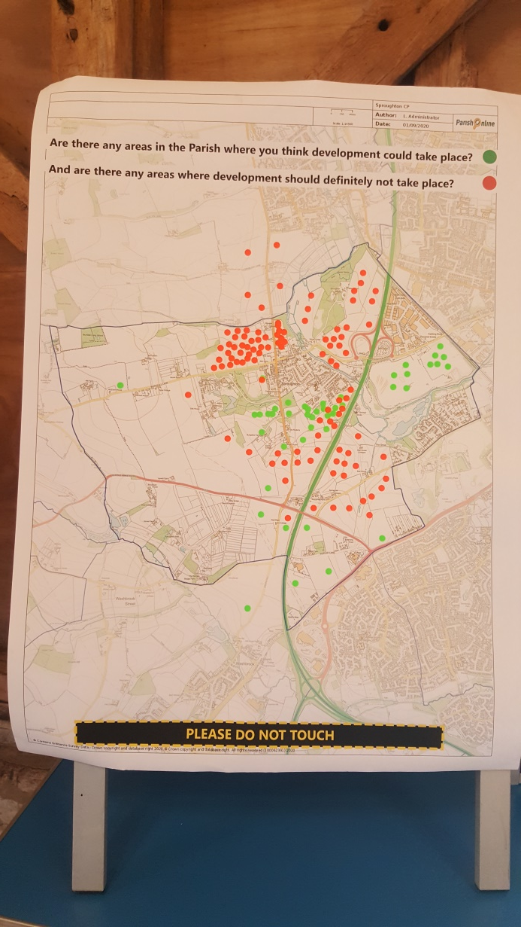
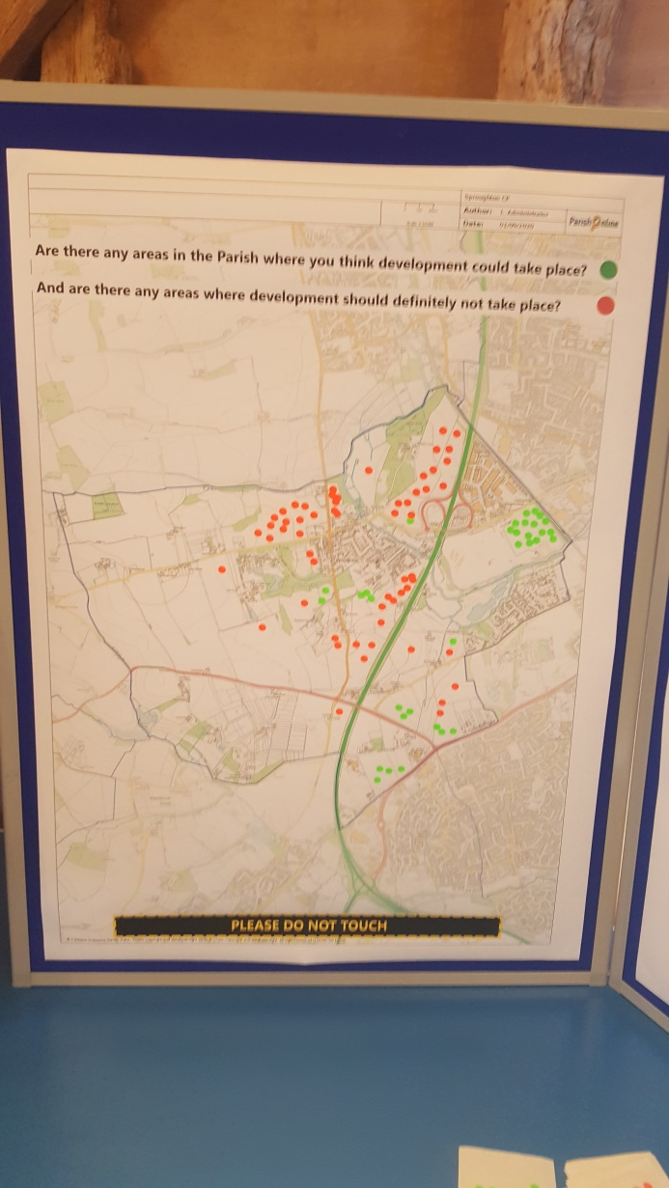
Boards 7&8 – Where ‘to Develop or not to Develop’

Slide 9
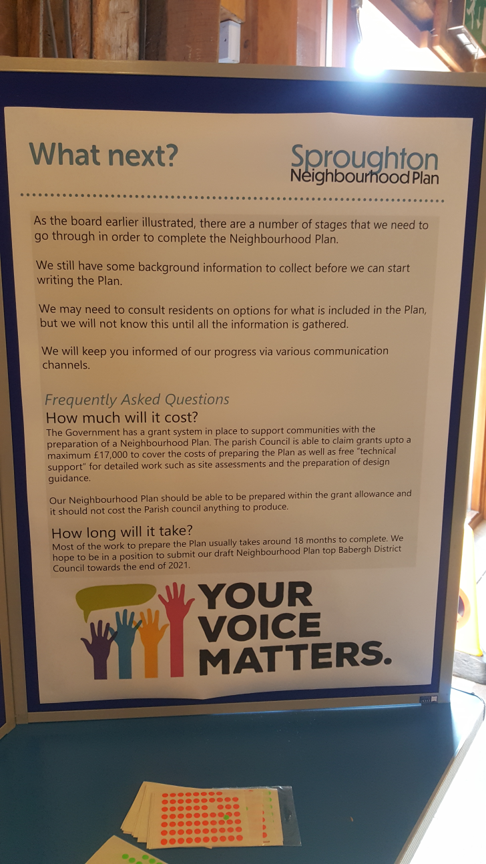
Board 9 – Next Steps

Slide 10
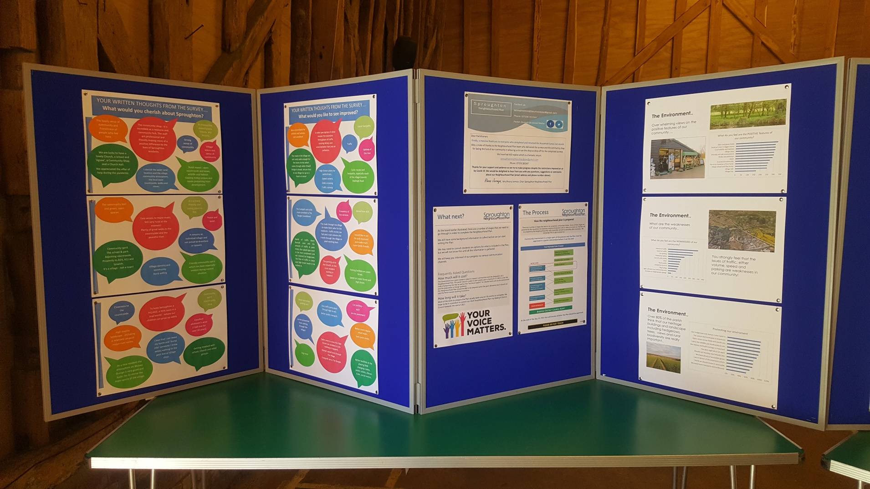
Board 10 – Comments from Parishioners

Slide 11
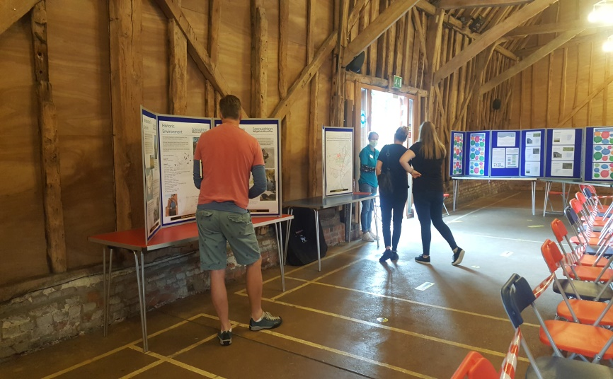
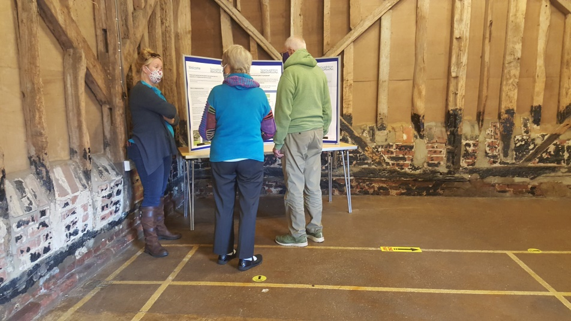
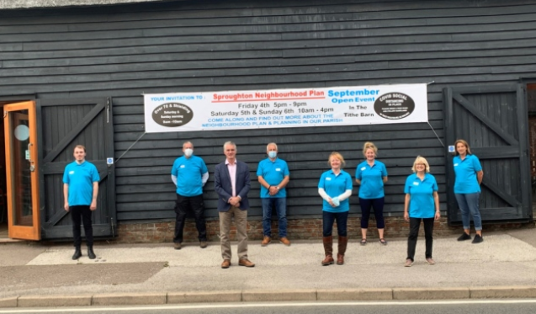
Some of our Visitors & the Neighbourhood Plan Team with our MP James Cartlidge

