Slide 1
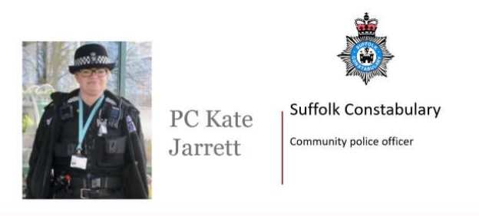
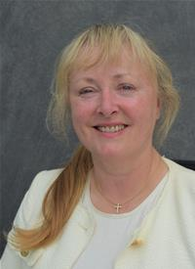

Sproughton Joint Surgery
An opportunity to speak to your district councillor and Sproughton’s community police officer.
Saturday 16th November
1pm-3pm
Tithe Barn, Lower Street.
District Councillor
Helen Davies

