Slide 1

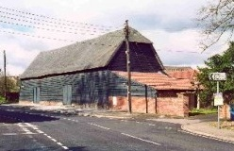
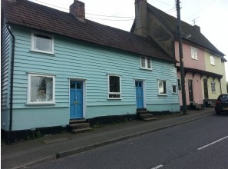
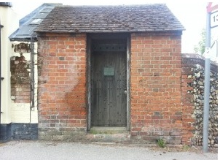
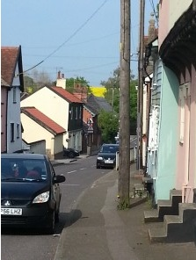
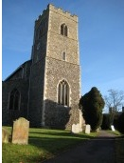

Sproughton Parish Council
Annual Parish Meeting (Year End 31Mar23)
Wednesday 3rd May 2023

Slide 2
Sproughton Parish Council
Our Councillors
  Helen Davies (Chair), Peter Powell (Vice Chair), Simon Curl, Jennifer King, Sharon Maxwell.
  Our Clerk, Kirsty Webber. Kirsty can be contacted at SproughtonPC@gmail.com,
  07538 311567,
  Tithe Barn, Lower Street, Sproughton IP8 3AA

Slide 3
Our Committees
Planning Committee
Neighbourhood Plan Committee
Sproughton PC
Finance Committee
Burial Committee
HR Committee
Beer Festival Committee
Traffic Committee

Slide 4
The Past Year – Committees
Sproughton Parish Council: Met every month including the normal holiday month of August due to the volume of work
Planning: Met fortnightly, each month to consider 26 planning applications. There were additional meetings (e.g. with residents, developers, Babergh) to consider the Pigeon & Taylor Wimpey sites.
Finance: Met twice to consider financial matters - budgets, precept & annual audit.
HR Committee: Have met once this year.
Burial Committee: Has not met this year
Neighbourhood Planning Committee: Formed early 2020. Has met as required to work on the Neighbourhood Plan. There have been a large number of ancillary meetings to discuss specific issues
Beer Festival Committee: Has met to arrange the annual Beer Festival. The Beer Festival Sub-Committee has met many times
Traffic Committee: Was resurrected and has met once so far

Slide 5
Allotments
The Parish Council leases the allotments from the Felix Thornley Cobbold Trust and manages these on a day to day basis.
FTCT annual rent = £445.00
Rental income from plot holders = £1711.48
payments are now in advance rather than
arrears.
New Allotment Agreement now in place
There are no plots available currently .

Slide 6
Burial Ground
Sproughton PC authorises burials and the erection of memorials
SPC is responsible for the management of the burial ground in Church Lane
Regular maintenance takes place e.g. grass & hedges cut, paths cleared & swept
Sproughton PC has considered expansion of the burial ground but do not need to make a decision for a few more years yet

Slide 7
Tithe Barn
Sproughton PC manages the use, maintenance & improvement of this important village resource
Our Tithe Barn wardens are David Barnes and Sam Pateman-Gee who manage day to day use of the barn, assist with hiring arrangements, ‘meets and greet’ hirers and oversea any functions.
Mike & Shirley Herbert are our Tithe Barn Caretakers who maintain the barn.
Sproughton PC is the ‘Designated Premises Supervisor’ administering the requirements of the Premises Licence (change to previous arrangements).
We have begun to consider upgrading facilities and improving our offering to hirers

Slide 8
Sproughton PC – Planning
Pigeon Land Management/FTCT (105 homes)
  Refused Summer 22, application withdrawn by Pigeon
  Excluded from Neighbourhood Plan
Taylor Wimpey (750 homes)
  Application granted for outline planning permission Jan’25
Sugar Beet Site/Sproughton Enterprise Park
  Smaller applications around infrastructure e.g change in access road length, new roundabout
  Issues with TPO’d trees cut down
  Waiting for the next ‘big’ application
  Concerns around planting & sustainability

Slide 9
Traffic
Our traffic committee has been resurrected
Working on the A14 diversion issue
Traffic calming measures for the High Street
Other issues:-
  Lack of parking at key locations
  Speeding (upcoming SIDS installation)
  Potholes

Slide 10
Sproughton Neighbourhood Plan
This project began in Jan’20
Neighbourhood Plan Committee set-up consisting of members of the Parish Council & Sproughton Working Group, chaired by Rhona Jermyn of the SWG
After much hard work the plan is now being reviewed by the planning inspector
Referendum likely early/mid-Summer
The plan carries some weight at the moment but has full weight after it is ‘made’ i.e. people have voted to accept it

Slide 11
Other Initiatives
Speedwatch
Children’s Playground
Other Initiatives
  A Greener Sproughton
  Conservation Area
  Improve Public Rights of Way (PRoW)
  More community events under consideration

Slide 12
Events
We held many successful events this year.
  Beer Festival
  Race Night
  The Big Lunch Jubilee Celebration
  Afternoon Tea
  The Christmas Weekend

Slide 13
Finances
FINANCE REPORT1
Budget | £77,146.00 | Precept | £69,266.00
Reserves | £454,784.00 | Current Account | £138,030.00
Expenditure
Burial Ground | £ 2,411.00 | VAT | £ 6,952.00
Allotments | £ 1,034.00 | Tithe Barn | £ 36,345.00
Grants & Other Activities | £ 500.00 | Administration | £7,516.00
Street Lighting | £ 2,992.00 | Neighbourh’d Plan | £ 2,436.00
Play Area/Public spaces | £ 2,608.00 | Staff Expenditure | £ 14,027.00
 |  | Total Spend | £76,821.00

Slide 14
Finances cont…..

Slide 15
Thank-You’s go to
All the parish councillors who volunteer their time and the people who help us out on the various events
The Neighbourhood Plan Committee who have put in significant hours to get us to this point ably led by Chair, Rhona Jermyn
Our Tithe Barn Wardens – David & Sam
Our village caretakers Mike Herbert Ltd – Mike& Shirley
The Beer Festival Committee
The resurrected Traffic Committee
The ‘Dream’ Team who organise the Tea Party & Christmas Weekend
And all the organisations in the village who put so much time and effort in to benefit the community:-
  Primary School, All Saints Church, Community Shop, Millennium Green, PFMC, Reading Room, Brownies, Bumble Bees charity

Slide 16
Not Forgetting
Our brilliant Clerk – huge thanks go to Kirsty for her efforts over the past year

Slide 17
Questions from parishioners

