Slide 1
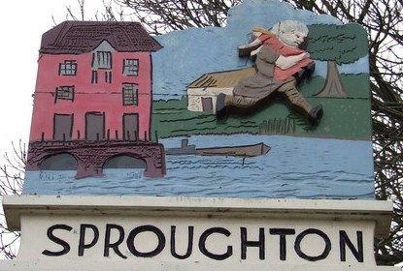
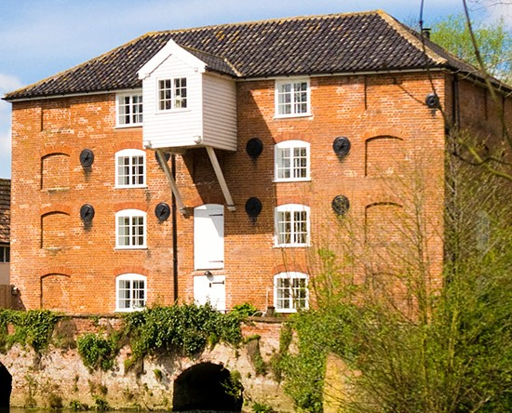
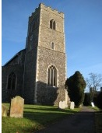
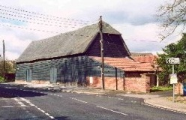
Sproughton Parish Council
Annual Parish Meeting (Year End 31Mar25)
Wednesday 14th May 2025

Slide 2
Sproughton Parish Council
Our Councillors
  Jennifer King (Chair), Sharon Maxwell (Vice Chair), Simon Curl, Helen Davies, Peter Powell, Charlie Barber, Rhona Jermyn, Alain Rosenberg and John Pateman-Gee.
  Our Clerk
  Kirsty Webber can be contacted at
  clerk@sproughton-pc.gov.uk
  07538 311567,
  Tithe Barn, Lower Street, Sproughton IP8 3AA

Slide 3
Our Committees
Planning Committee
Neighbourhood Plan Committee
Sproughton PC
Finance Committee
Burial Committee
HR Committee
Beer Festival Committee

Slide 4
The Past Year – Committees
Sproughton Parish Council Committee
  Met every month including the normal holiday month of August due to the volume of work
Planning Committee
  Met fortnightly, each month to consider 46 planning applications. There were many additional meetings.
Finance Committee
  Met two times to consider financial matters such as budgets, precept & annual audit.
HR Committee- Have not met this year.
Burial Committee
  Have not met this year
Neighbourhood Planning Committee
  Formed early 2020.
  Beer Festival Committee
  Has met to arrange the annual Beer Festival, which was held at the weekend.

Slide 5
Allotments
The Parish Council leases the allotments from the Felix Thornley Cobbold Trust and manages these on a day-to-day basis.
FTCT annual rent = £445.00
Rental income from plot holders = £846.50
payments are now in advance rather than
arrears.
Water Rates = £617.46
There are currently 3 plots available.

Slide 6
Burial Ground
Sproughton PC authorises burials and the erection of memorials.
SPC is responsible for the management of the burial ground in Church Lane
Regular maintenance takes place e.g. grass & hedges cut, paths cleared & swept and cleared.
Sproughton PC has continues to consider expansion of the burial ground

Slide 7
Tithe Barn
Sproughton PC manages the use, maintenance & improvement of this important village resource.
Our Tithe Barn warden is Sam Pateman-Gee who manages day to day use of the barn, hiring arrangements, ‘meets and greet’ hirers and overseas any functions.
Mike & Shirley Herbert are our Tithe Barn Caretakers who maintain the barn.
Sproughton PC is the ‘Designated Premises Supervisor’ administering the requirements of the Premises Licence (change to previous arrangements).

Slide 8
Sproughton PC – Planning Work
Chantry Vale
Sproughton Enterprise Park

Slide 9
Sproughton Neighbourhood Plan
In December 2024, the Government introduced new housing requirements, increasing targets for Babergh and Mid Suffolk.
New targets:
  Babergh - 775 homes/year (up 86%)
  Mid Suffolk - 734 homes/year (up 37%).
All councils must show a five-year housing land supply. The new requirements make this challenging, risking national policies overriding the Joint Local Plan (JLP).
Therefore, there is to be a full review of the Joint Local Plan, by BDC and BMSDC. This review is needed to address these higher housing requirements.

Slide 10
SPROUGHTON NEIGHBOURHOOD PLAN
CONT…..
Impact on the Sproughton Neighbourhood
Plan:
In order to align with national policy changes there is to be ongoing work with towns and parishes with regard to Neighbourhood Plans.
This means that our Neighbourhood Plan needs to reflect these changes whilst protecting our parish from further development that potentially could be dictated to us, through government or local authorities.
We are in the initial stages of gathering information and applying for grants to enable us to review our current plan, in preparation for the New JLP expected in late 2026 and also manage the potential impact of Local Government Restructure, where the Government plans to create new mayoral authorities and unitary councils by 2028.

Slide 11
Events
We held many successful events this year.
Beer Festival
Afternoon Tea
Christmas Carols
Fun Quiz

Slide 12
PLAYING FIELD
As of Jan25 SPC became the sole trustees of the playing field. The playing fields are run completely separately to the PC, with a committee who oversees the day to day running of the field. They are currently trying to get CIL funding to upgrade the play area.

Slide 13
Finances
FINANCE REPORT1
Budget | £75,711.00 | Precept | £70,784.00
Expenditure
Burial Ground | £ 606.00 | VAT | £ 13,082.00
Allotments | £ 1232.00 | Tithe Barn | £ 22,003.00
Grants & Other Activities | £ 2433.00 | Administration | £36,374.00
Street Lighting | £ 3906.00 | Neighbourh’d Plan | £ 2,500.00
Play Area/Public spaces | £ 13,132.00 | Staff Expenditure | £ 15,619.00
 |  | Total Spend | £110887.00

Slide 14
Thank-You’s go to
All the parish councillors who volunteer their time
The Neighbourhood Plan Committee who have put in significant hours to get us to this point
Our Tithe Barn Warden
Our village caretakers Mike Herbert Ltd
And all the organisations in the village who put so much time and effort in to benefit the community:-
  Primary School, All Saints Church, The Community Shop, The Millennium Green, The Reading Room, Brownies, Bumble Bees charity.

Slide 15
Questions under #6

